Slide 1
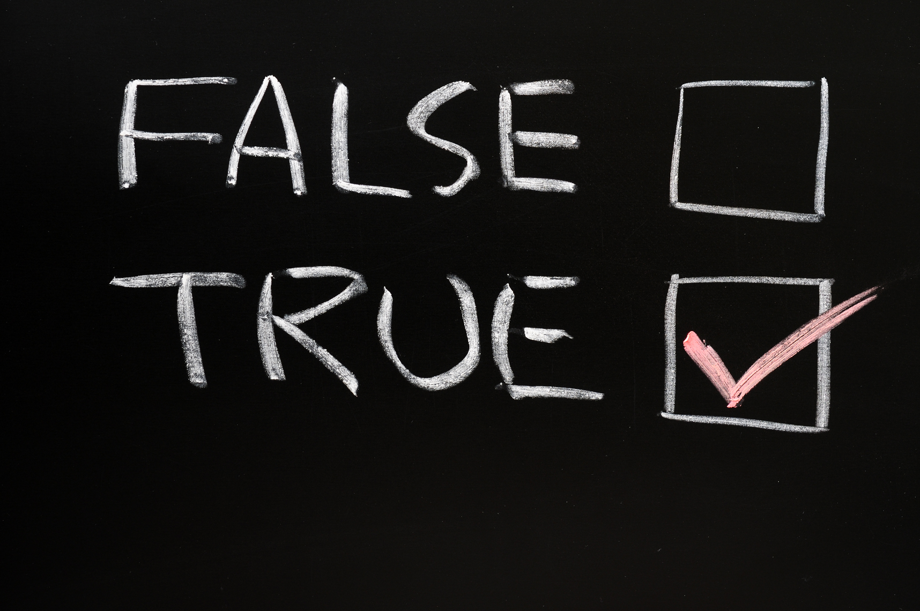
Summer Challenge on Automatic Evaluation of Handwritten Answer Sheets
Team AI Avengers :Akshat Jain, Gaurav Manish, Rutam Rajhansa, Mukund Gupta

Slide 2

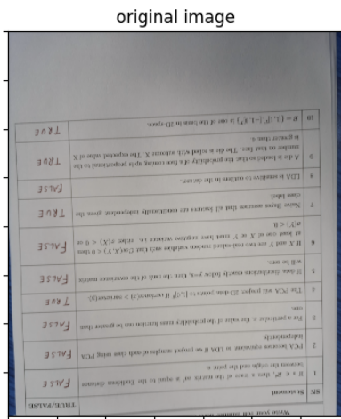
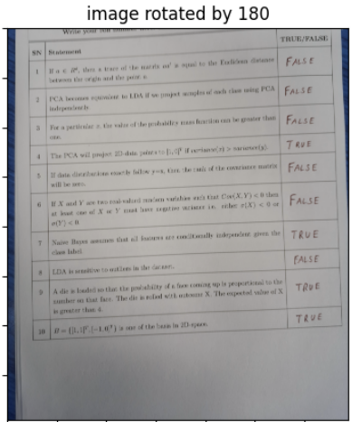


Overall Process and Workflow
Start
A) Detect Orientation
Function used: get_image_orientation(image_path)
B) Correct Image Orientation
Function used: correct_image_orientation(image_path)
Original Image
Rotated Image
Detect the orientation of the text in the image Using PyTesseract and return the angle.
Detected Angle- 180deg

Slide 3
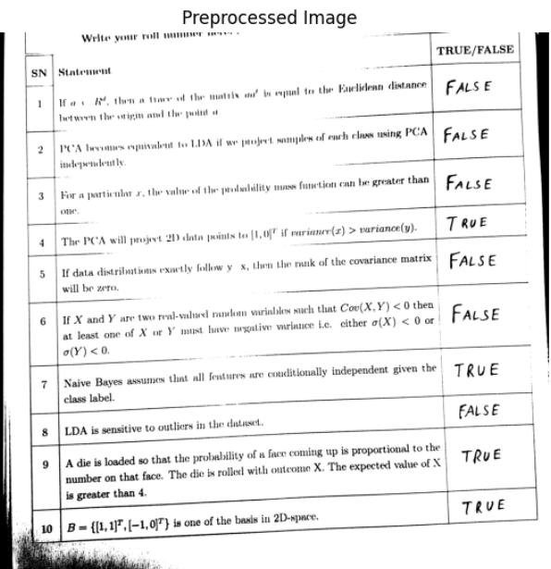
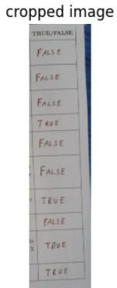


Overall Process and Workflow
C) Preprocess and Text Conversion
Fuction Used : preprocess_image(img)
D) Boundary Detection & Crop Image
Function used: get_bound(image),crop_image(image_path)
Detects the column where space for answer is given.
Then the image is cropped to get only relevant portion of the image

Slide 4

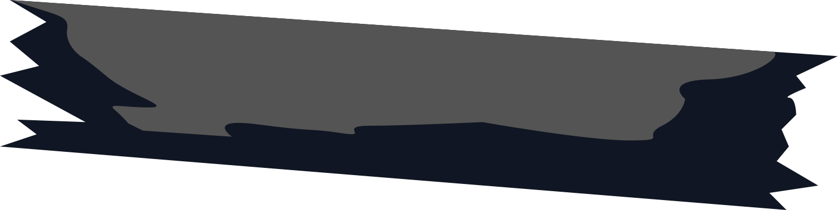
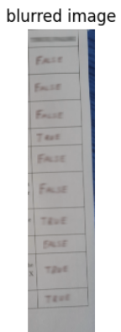
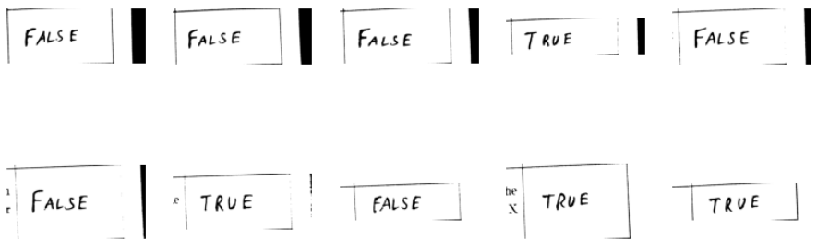
Overall Process and Workflow
E) Blur Text Regions & Detect Lines
Function used: blur_text_regions(image_path)
detect_lines(image_path)
F) Divide Image into Parts
Function Used: divide_image_into_parts(image, lines)
Divides the image into 10 parts based on detected lines thus seperating each cell into a single image for improving performance of OCR
Detects the text in image and blurs it to improve the accuracy of Line Detection done using Hough Line Transform

Slide 5

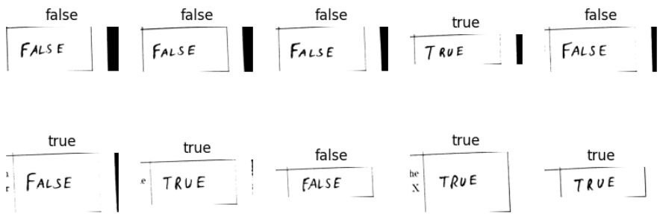
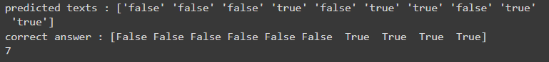
Overall Process and Workflow
G) Get Predicted Answers & Match with True/False
Function Used: get_predicted_answers(image_path)
H) Calculate Marks
Function used: cal_marks(a1, a2)
Applied EasyOCR on divided images and matched the predicted text to true/false using fuzzywuzzy library
Correct Answer Dataframe is loaded and is matched with predicted answers to get the predicted score of the answersheet.
End

Slide 6
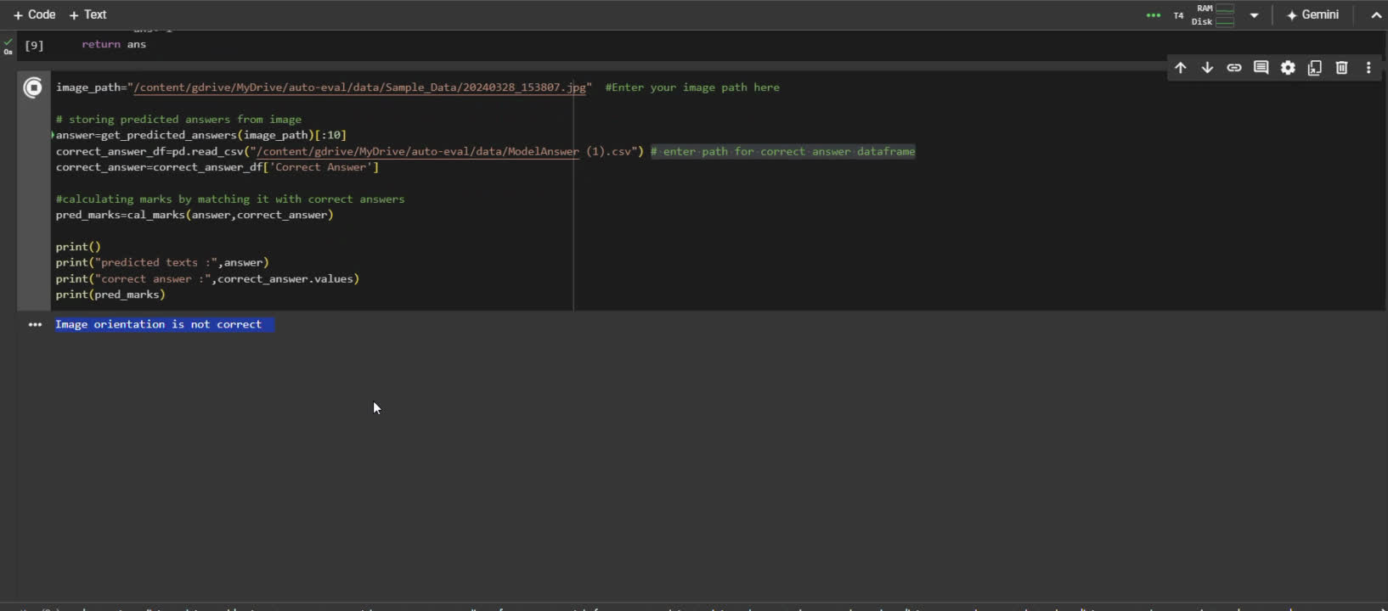
Demo Video and git-hub links
Demo video link
Git-hub repo Link : https://github.com/akshat2635/auto-eval

Slide 7
THANK YOU!

